Slide 1

Project Based Learning
GSM BASED INDUSTRIAL FIRE DETECTION AND FIRE CONTROLLER
S.NO | Name of the student | Roll No. | Branch
1 | C.Pralavi | 21955A0415 | ECE
2 | V.Neelima | 21955A0411 | ECE

Slide 2
PROBLEM STATEMENT
Every year, billions of dollars in property damage occurs as a result of Fire.Fire accidents can result in catastrophic personal injury and devastating damage. Victims of fire accidents can suffer serious harm, including burn injury to their entire body. Fire accidents can cause death not only from burns but also from smoke inhalation and toxic gases to prevent all the damage caused by the fire accidents we can make use of this project in industries. Because of the speed and totality of the destructive forces of fire, it constitutes one of the more serious threats. Hence to prevent it we need a fire extinguisher.

Slide 3
Our project can be used in industries,hospitals,shopping malls,educational institutions,at last in appartments too.It can be proposed at every place where there is a chance of occurring fire.

Slide 4
PROPOSED SOLUTION
The project itself indicates that the system checks the fire in the Industry, based on that we get a message alert to the Registered mobile number and automatically fire extinguisher turns on to stop the fire. Here we use one fire/smoke sensor. When fire is detected by the flame sensor then it gives high signal To Arduino input. Arduino is programmed in such a way that it gives The message to the user/owner through the GSM 900A.

Slide 5
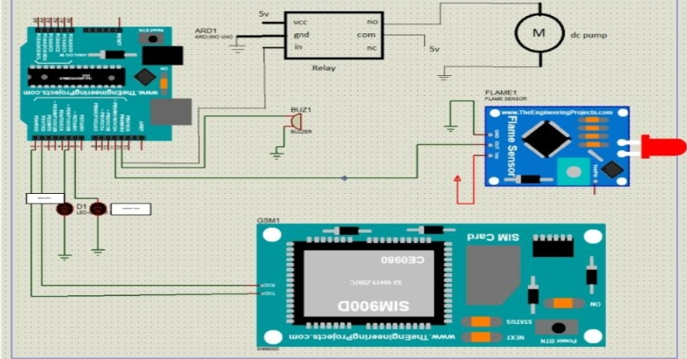
PROOF OF CONCEPT/PROTOTYPE DETAILS

Slide 6
Using Arduino the fire is detected through flame/smoke sensor and when the fire is detected through Arduino message alert is sent to the owner/police/fire/ambulance using GSM and fire extinguisher turn on until all the situations were under control. To prevent all the damage caused by the fire accidents we can make use of this project in industries. It sends a acknowledgement to the user / police and Also controls the fire with fire extinguisher.

Slide 7
VALUE PROPOSITION
We know that when the fire occurs in industry automatically the alert systems in the industry will be on.But it is only up to that industry.The action takers(public/police/hospitals)doesn’t knows about there is a fire in industry.So it is hard to save their lives and there will be property loss also .Our project deals with GSM and motor pump which is already installed.Through GSM alert messages will be sent to police,ambulance,and fire department and the installed fire extinguisher will automatically put the fire off.

Slide 8
COMPETITION
The other solutions are using fire or smoke sensors but they do not intimate the fireplace but in this project by Using Arduino the fire is detected through flame/smoke sensor and when the fire is detected through Arduino message alert is sent to the owner/police/fire/ambulance using GSM and fire extinguisher turn on until all the situations were under control. To prevent all the damage caused by the fire accidents we can make use of this project in industries. It sends a acknowledgement to the user / police and Also controls the fire with fire extinguisher.

Slide 9
THANK YOU

